Slide 1
Gradient Descent

Slide 2
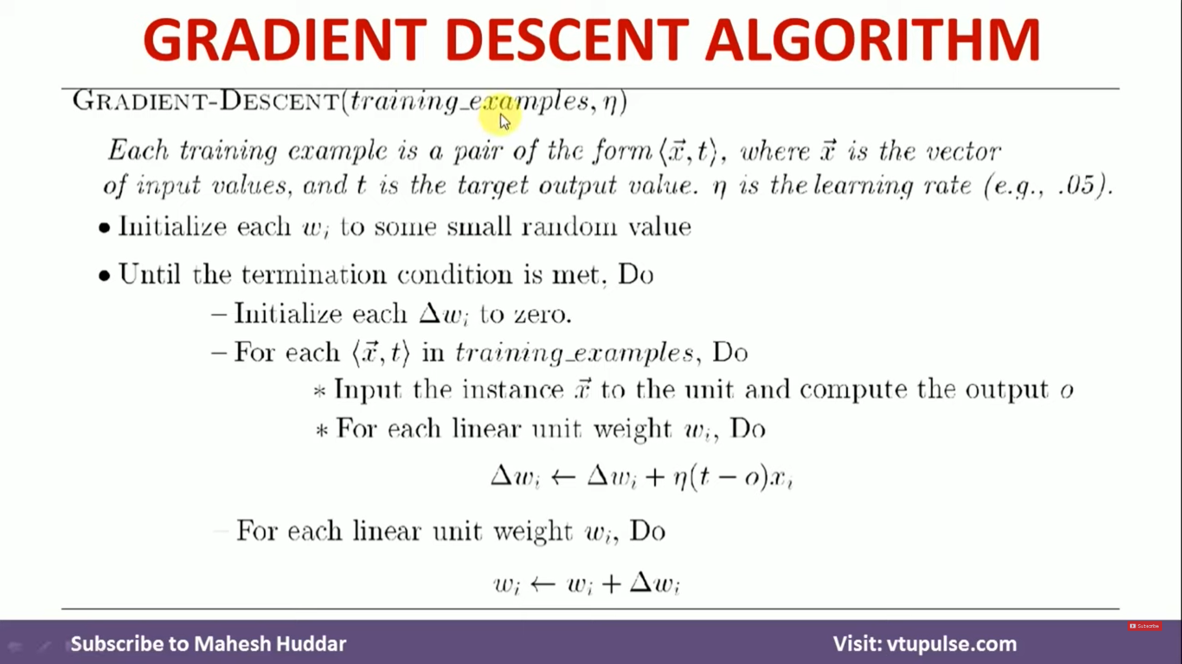
Gradient Descent Algorithm

Slide 3
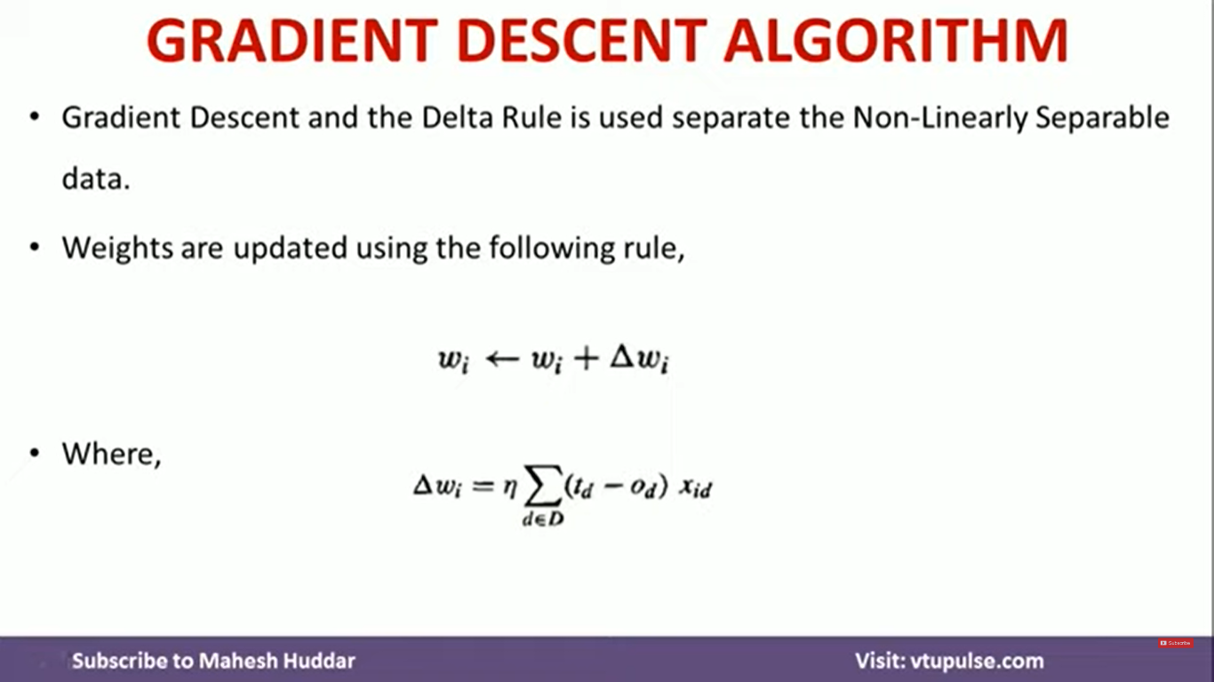
Gradient Descent Algorithm

Slide 4
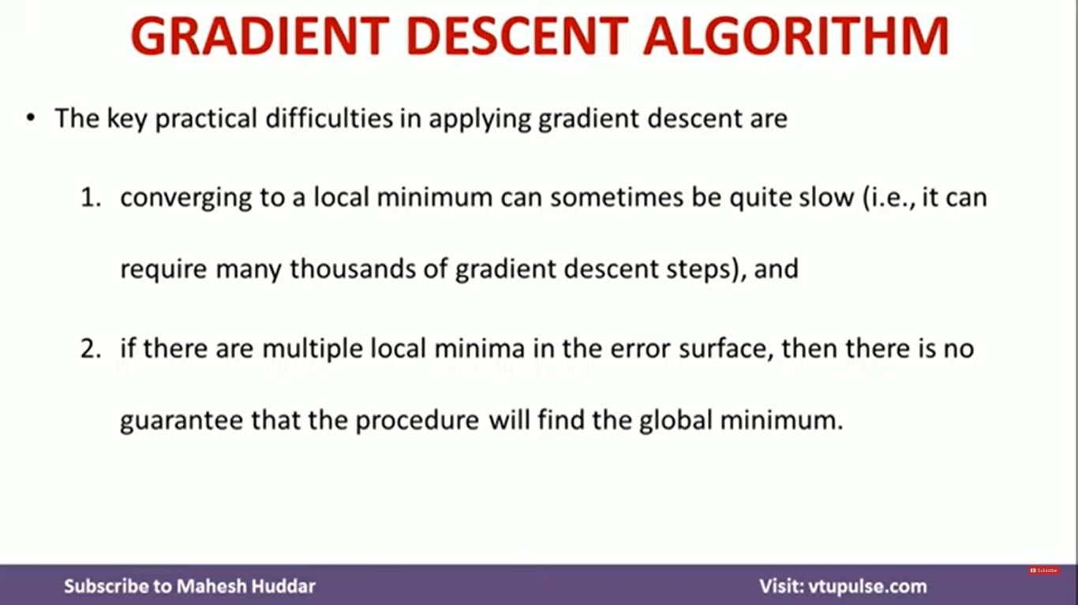

Slide 5
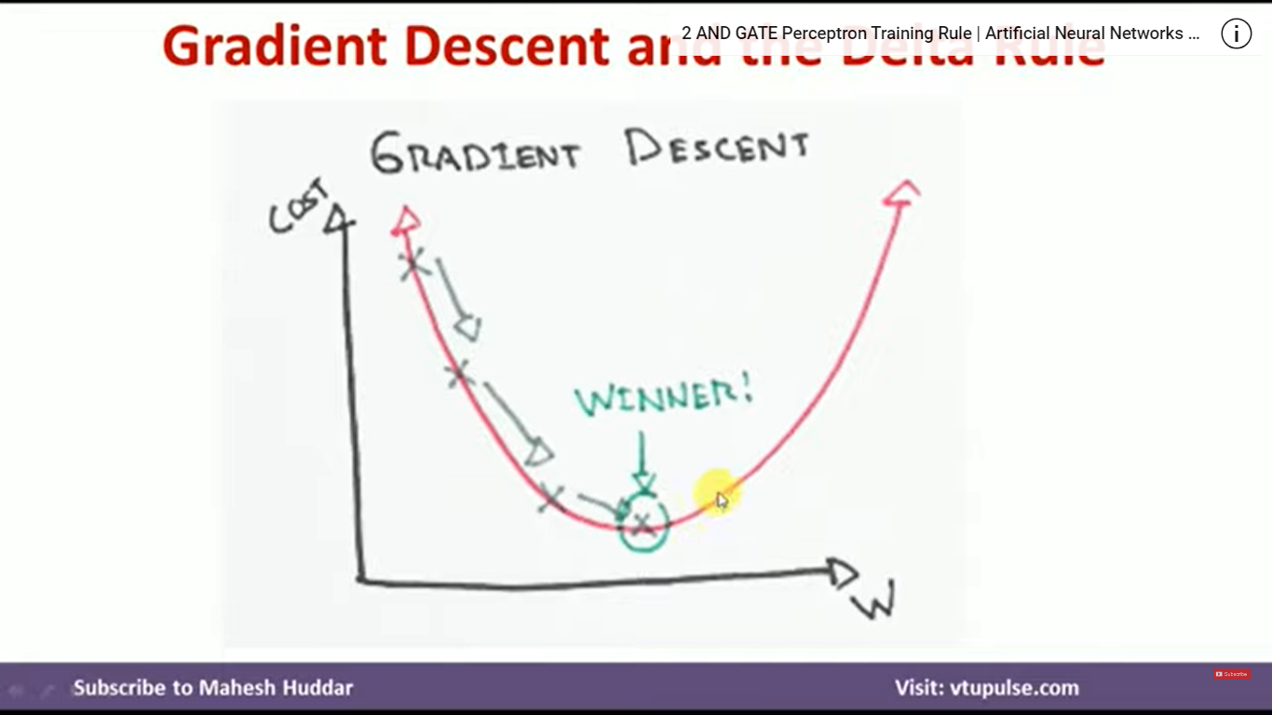
Gradient Descent Algorithm

